Slide 1
UVS Team 1
We did it !

Slide 2
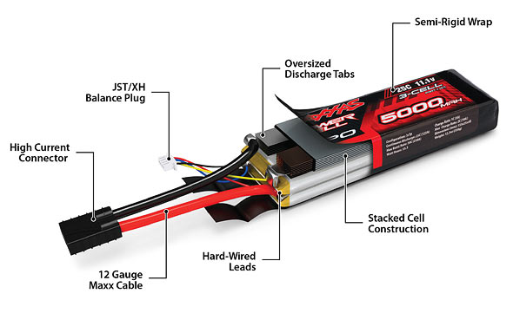
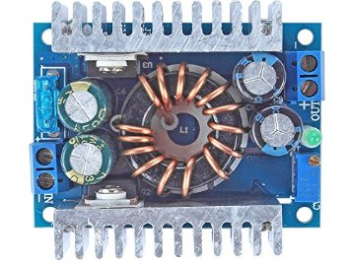

How we did it
Nuc is powered by 4cell LiPo battery with 14.8V via power cable
A power cable is soldered with a 5.5x2.5 mm DC power plug
Notes:
Power terminal block receives power from the 3 cell 11.1V LiPo battery
Both the phidget receives power from the power terminal block to the power and ground port by Y cable .
Where as the output for the both phidget motors is connected to motors for left side and right side respectively.
The encoder is connected to 5 pin port for both the left and right central motor.
interchange of A and B i.e yellow and white wired pins of the encoder for left motor in compared to right motor encoder is done for encoder counting in correct direction.

Slide 3
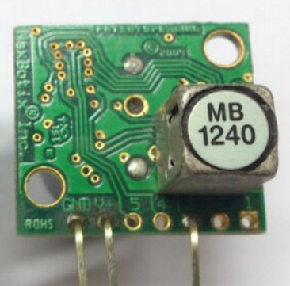
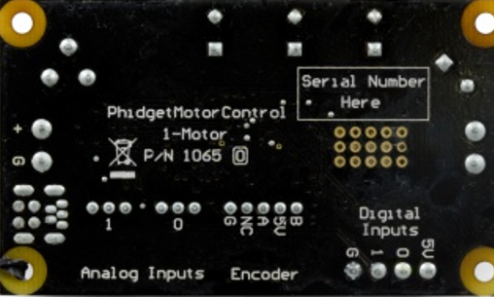
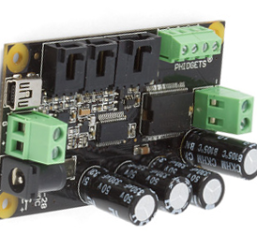
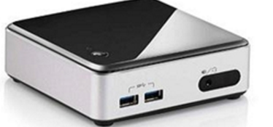


3 pin output from XL-Max Sonar senor is connected to the 0 input of one of the phidget.
Nuc is o/p signal is connected by usb 2.0 (longest cable ever) to both the left and right phidget.

Slide 4
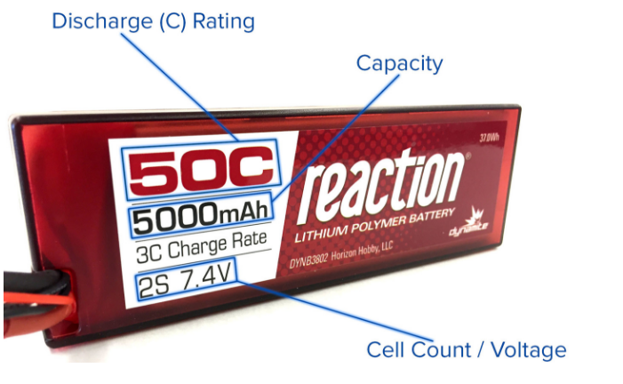
Charging Batteries
Manual setup data - cell count and charge rate
Double-check your settings i.e. cell count and current
Always read and follow the instructions from manufacturer
Never leave the battery charging unattended
Battery Lingo :
1000mAh = 1 Amp Hour (1Ah)
20C = 20 x Capacity (in Amps) Calculating the C-Rating = 20 x 5 = 100A
Each Cell =3.7V
Our battery = 4s = 4 cells in series=4x3.7=14.8V
Internal Resistance=16mohms

Slide 5
Safety Operating Vehicle With Battery
Never let your LiPo get near water, even when its on fire
Do not reverse your positive and negative leads
Always inspect your LiPo battery after each use.
In the event of a crash, secure and isolate your LiPo for at least an hour, even if it visually appears to be OK.
Do not continue using it if the packaging is torn or punctured or if you notice any ballooning of the battery.
Donot charge LiPo battery when not in your sight

Slide 6
Handling Damaged Batteries
If a damaged battery leaks on your skin, wash immediately with soap and water.
In the event it gets into your eyes, flush with cool water and seek medical attention, also question yourself what were u doing ?
If the battery is damaged or ballooned, skip the discharging step and go straight to salt water submerging.
After 2 weeks the LiPo can now be disposed of in designated trash.
Don’t charge a damaged battery
Do not try to put out a LiPo fire with water , try CO2 its awesome !

Slide 7
ROS and the NUC
Thanks to our TA we basically never had to go through the tedious work of actually installing Ubuntu, ROS or Matlab on the NUC.
We did end up dual booting our own PCs with Ubuntu and ROS though
First challenge : Get the Hotspot configured on the NUC with desktop sharing option.
Second challenge : Getting the desktop share to work
Third Challenge : Making Simulink work with the VGA cable hack (should receive nobel prize)
Notes:
Donot share our id and password

Slide 8

Ubuntu Tutorials (Special thanks to dummies.com)
Unkown to this specific OS, we learnt various shortcut keys and Terminal commands
ls list files and directories ls -a list all files and directories mkdir make a directory cd directory change to named directory cd change to home-directory cd ~ change to home-directory cd .. change to parent directory pwd display the path of the current directory

Slide 9

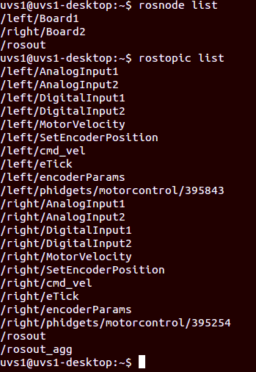
ROS Steps
Step 1 : Ros core must be running behind
In terminal enter Roscore and open another terminal
Step 2 : Connect the phidgets with the provided USB B type connectors
Step 3 : How to see the connected Phidgets: In the terminal change directory to that of phidget example and then type sudo ./manager and rejoice when u see them connected. Step 4: How to create nodes using phidgets In the files menu go to the Directory Libphidgets > phidgets > change the serial numbers on the .launch file using Gedit Then opened a terminal went to the phidgets directory mentioned above and roslaunch of that .launch file It gave us parameters , nodes and started with 2 PIDs for both left/board 1 and right/board 1 Step 5:How to see Ros nodes and Topics
In the terminal type the following commands rosnode list > rostopic list > .

Slide 10
Simulink Steps
Step 1: Execute the Parameter files for .slx file provided
Step 2: Find the blank message in the file and select geometry/twist for both left and right
Step 3: Ensure the bus connected to the blank message is receiving and giving out data.
Step 4: Find the Publisher block and make sure it is publishing data as int 32
Step 5: Find the Subscriber block and make sure its getting data and labelling it as etick(left and right appropriately)not ethick.
Step 6: Run the slx file (Don’t let your rover run away) , check for the encoder readings from eticks. Confirm they reach 32000 and -32000
Step 7: High five your teammates !

Slide 11
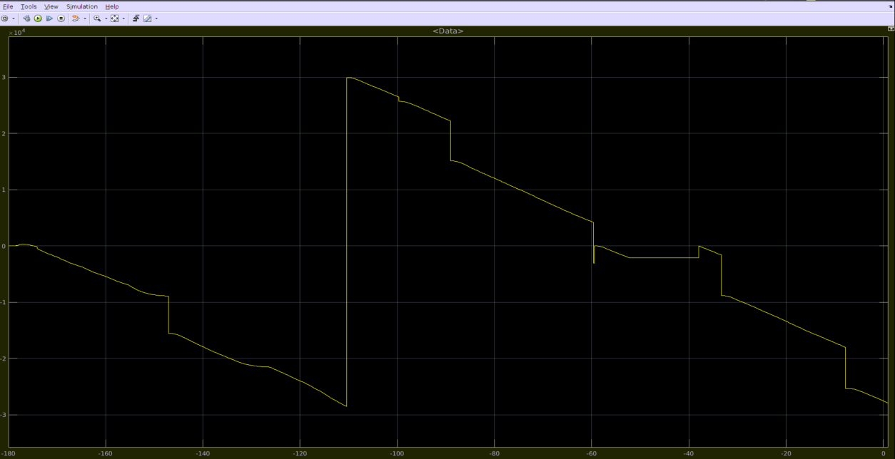
Encoder results should look something like this

Slide 12
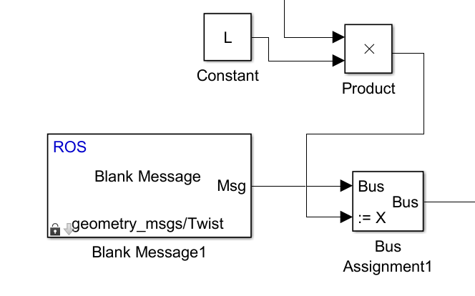
Addition to Simulink File
Addition of 2 variable L and R which control the duty cycles on the platform so that the rover doesn’t have to constantly run at its maximum velocity.
If time variable is figured out we will be able to give a specific path on the basis of information provided to us that is at 100% duty cycle the velocity of the rover is 0.535 m/s.
Note. L and R should always be within the range of -1 and 1.

Slide 13
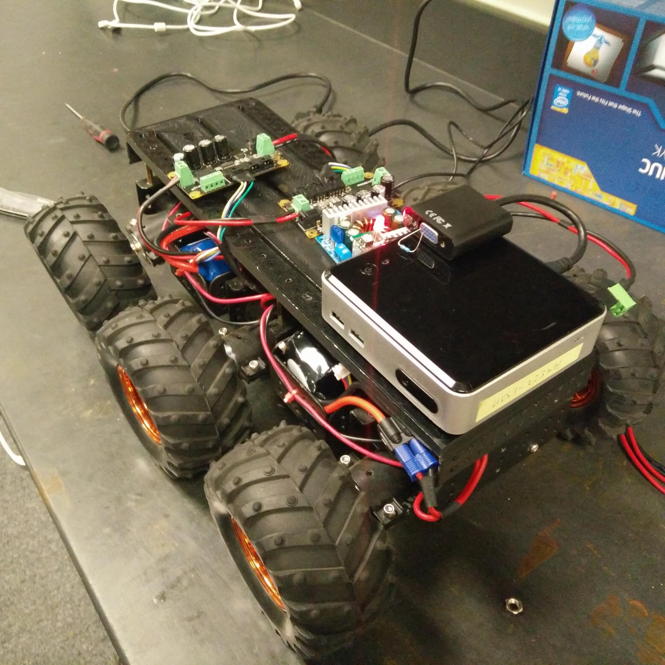

Thank you
Team Members:
Antonio Bermudez
Nitesh Panchal
Sandeep Chahal
Shaad Jafri
Tabin Gautam

